Slide 1

Testing and Test Automation in Data Pipelines
This presentation will delve into the critical aspects of testing and test automation within data pipelines, providing a comprehensive overview of best practices, tools, and advanced concepts.
Abdullah Cheema Usman Anwar

Slide 2
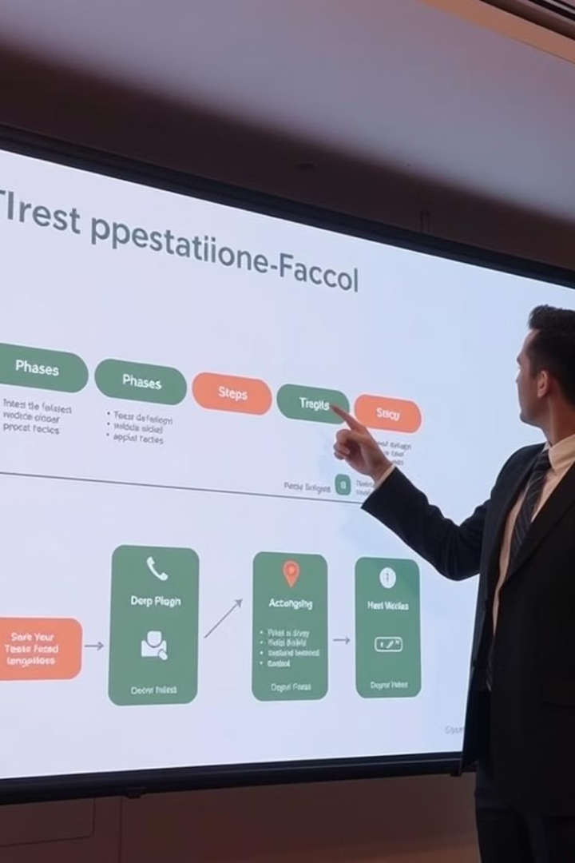
Overview of the Presentation
1
Demo of Testing Solutions
2
Summary of TestOps Report
We'll showcase practical examples of how to implement test automation using JUnit and Maven.
Learn about the benefits and principles of TestOps, a modern approach to testing.
3
Advanced Topics Explored
We'll discuss advanced tools like Katalon TestOps and TestKube for enhanced testing capabilities.

Slide 3
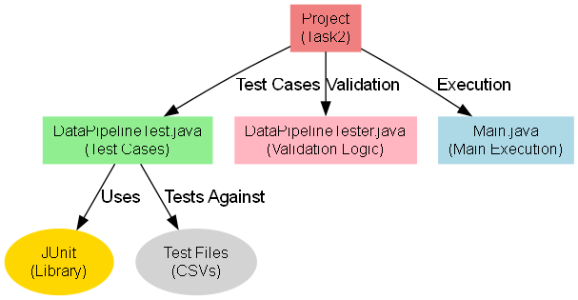
Demo of Testing Solutions
Tools Used
Features of the Test Suite
Project Structure Diagram
JUnit for automated test cases.
The test suite encompasses various scenarios, including validation of CSV data, handling valid and invalid data, and testing for file errors.
Maven for dependency management.

Slide 4

Test Case Examples
Test Type
Description
Output
Valid Data Test
Checks if a valid CSV file passes all validation criteria.
Returns true if valid.
Invalid Data Test
Ensures invalid data (e.g., missing fields) fails validation.
Returns false.
Missing File Test
Tests for IOException when a file is missing.
Throws an exception.

Slide 5
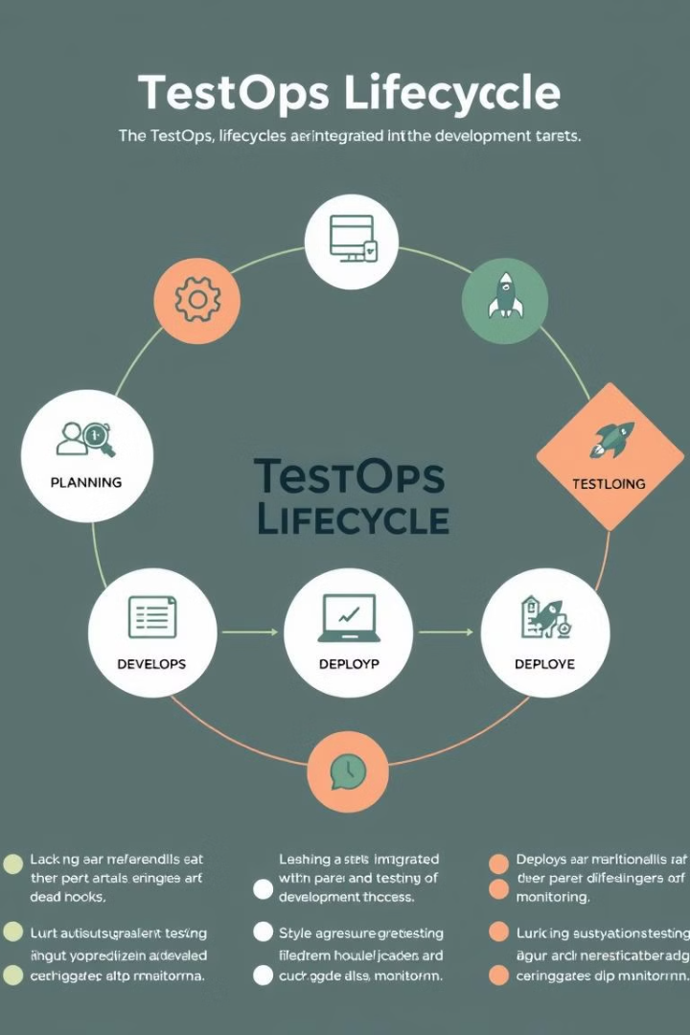
Summary of TestOps Report
What is TestOps?
Key Benefits
TestOps is an operational approach that emphasizes efficiency and continuous improvement throughout the testing lifecycle.
TestOps fosters faster feedback loops, enhanced test management, and improved collaboration between teams.

Slide 6



Tools Explored in TestOps
Katalon TestOps
Katalon TestOps provides centralized test management, integration with CI/CD pipelines, and advanced analytics capabilities.
TestKube
TestKube specializes in Kubernetes environments, orchestrating tests across popular tools like Postman, Selenium, and Cypress.

Slide 7
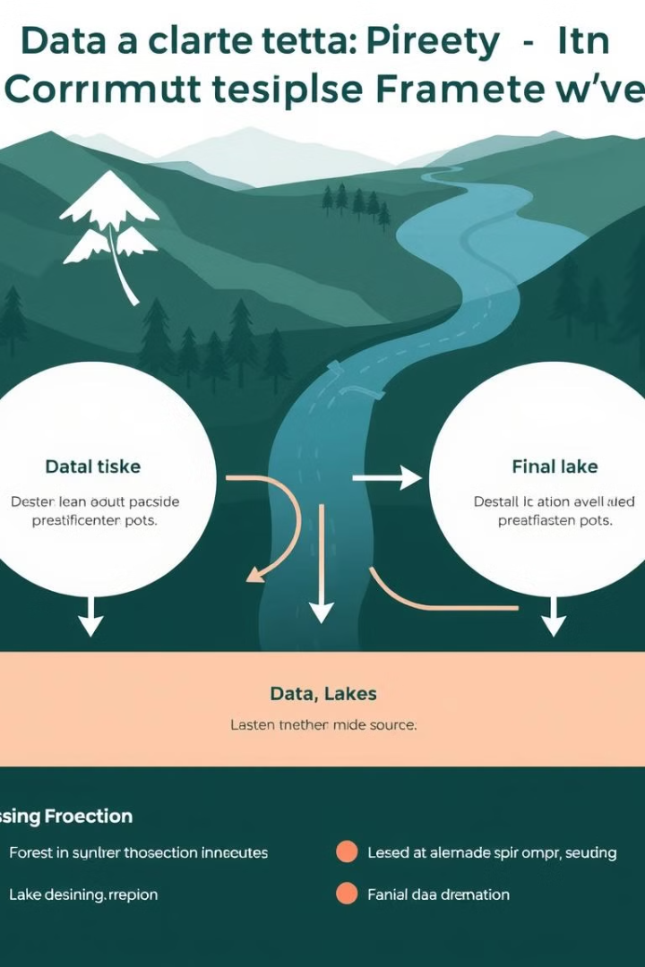
Advanced Topics Explored
1
Identified Gaps
The current framework lacks a centralized dashboard, detailed analytics, and real-time monitoring capabilities.
2
Proposed Solutions
We propose implementing tools like Katalon TestOps and TestKube to address these gaps and enhance testing capabilities.

Slide 8
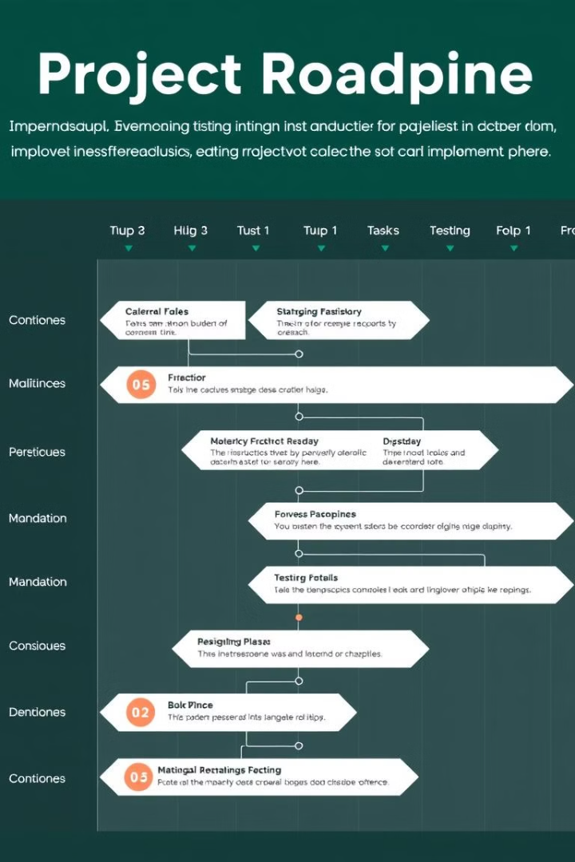




Implementation Plan
Analyze Needs
Choose Tools
Identify repetitive and time-consuming processes to streamline testing workflows.
Select appropriate tools based on specific requirements, such as Katalon TestOps for analytics and management, and TestKube for Kubernetes-native orchestration.
Integration
Train the Team
Integrate selected tools seamlessly with existing CI/CD pipelines to ensure smooth workflow.
Conduct comprehensive training sessions to familiarize team members with new tools and best practices.

Slide 9

Key Takeaways
1
Efficiency
2
Scalability
3
Quality
Automated testing streamlines validation processes, saving time and resources.
Tools like Katalon and TestKube enable testing for large-scale systems and complex data pipelines.
Early bug detection through robust testing practices improves overall software reliability and reduces potential risks.

Slide 10


Demo Screenshots
Successful Test
Failed Test
This screenshot demonstrates a successful JUnit test execution, indicating that the code is working as expected.
This screenshot showcases a failed JUnit test, highlighting an error in the code that requires further investigation and debugging.

Slide 11


Questions and Feedback Feel free to ask any questions about the demo, report, or tools explored.

